Slide 1

BUS7C1 CORPORATE STRATEGY AND INTERNATIONAL MANAGEMENT
Lecture 2 - Vision, Mission, Aims and Levels of strategy

Slide 2

By the end of today you will…
Be familiar with the meaning of Strategy
Be familiar with the Vision, Mission, Aims and Levels of strategy

Slide 3
Vision and values
A vision is a motivating summary of what an organisation hopes to achieve. It links the objectives with the core values of the business
Values are a set of ethical or operating principles and beliefs that guide decision making

Slide 4
What is a mission statement?
A mission statement is a written expression of the aims of the business.
The mission statement draws together the purpose,
values, beliefs and non-financial goals of an
https://www.youtube.com/watch?v=tXsxuw3EpDM

Slide 5
Aims
Aims are the long term goals of an organisation
“to ensure customer satisfaction”
“to deliver shareholder value”

Slide 6
Objectives
Objectives are medium term targets that act as
stepping stones to achieving the aims
“to achieve a return on equity of 16%”
“to increase profits by 10% in 2025”

Slide 7
Set Corporate Objectives
Objectives
Direct the firm’s course of action
Maintain action within the mission’s boundaries
Ensure the firm’s continuing existence
To implement an effective strategy, it is important to quantify objectives when possible
Intels Mission:
“to delight our customers, employees, and shareholders by relentlessly delivering the platform and technology advancements that become essential to the way we work and live.”
Intels Objectives:
Extend our silicone and manufacturing
Deliver unrivaled microprocessors and platforms
Grow profitability worldwide
Excel in customer orientation

Slide 8
What is Business For?
Every business has a unique purpose - typically this reflects the motives of the entrepreneurs who created these businesses
E.g. Henry Ford (Ford Motor Company), Steve Jobs (Apple), Jack Ma (Alibaba) were each motivated by a distinct vision.
Common to every business enterprise: the desire/need to create value
Value is the monetary worth of a product. Value can also come from non-monetary sources e.g. feel good factor! Hence, the purpose of business is
to create value for customers
to appropriate some of that value in the form of profit—in order to ensure the survival of the firm

Slide 9
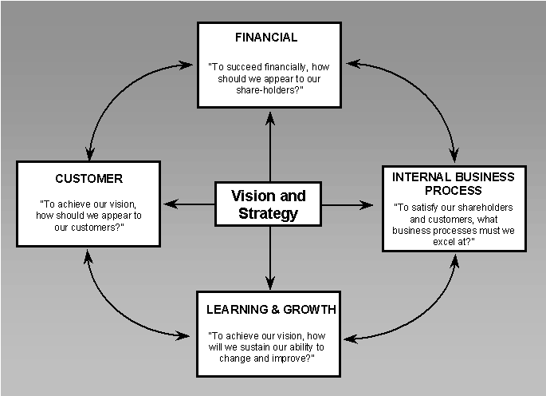
Vision and Strategy

Slide 10
Vision is a Critical Driver
VISION
Provides future direction
Expresses a consumer benefit
Is realistic
Is motivating
Must be fully communicated
Consistently followed and measured
To succeed in the long term, our business needs a vision of how we will change and improve in the future.
“without a vision, the people perish”
The vision of the business gives its energy.
It helps motivate us.
It helps set the direction of corporate and marketing strategy.

Slide 11
Purpose of aims and objectives
To provide direction for the organisation
To form a basis for allocating resources
To be motivational
To monitor performance
To measure success

Slide 12
What is Competitive Advantage?
“Competitive advantage is a company’s ability to perform in one or more ways that competitors cannot or will not match.”
Philip Kotler
“If you don’t have a competitive advantage, don’t compete.” Jack Welch, GE

Slide 13
What is Competitive advantage?
https://www.youtube.com/watch?v=xXF8aS-sbJI

Slide 14
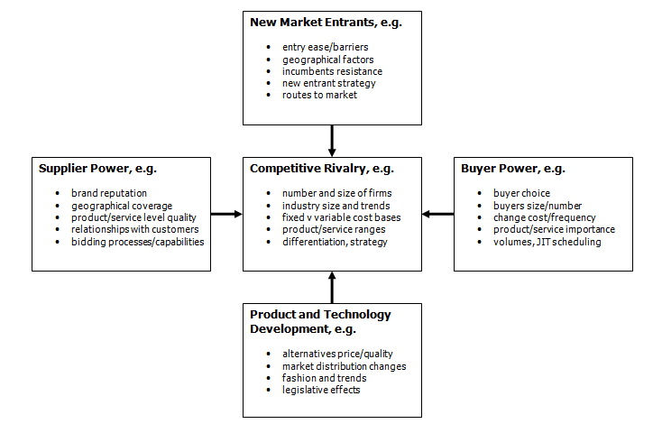
Porter’s 5 Forces of Competitive Positioning
1980s 1990s
Arm industry
Change in technology
Supplier if you buying

Slide 15
Porters 5 forces
https://www.youtube.com/watch?v=Moy8RQnV1kw

Slide 16
Value for Whom? Shareholders vs Stakeholders
The shareholder approach
The firm exists to maximize the wealth of its owners
The stakeholder approach
The firm is a coalition of interest groups —it must create value for them all
For the purposes of strategy analysis we assume that the
primary goal of the firm is maximizing profit over its lifetime
Rationale:
Competition: To survive a firm must earn return on capital > cost of capital. This is difficult when competition is strong.
Acquisition: Firms that do not maximize profits are vulnerable to acquisition.
Convergence of interests: long run profitability requires satisfied customers, motivated employees, and good relations with governments and communities.
Hence: Strategy analysis is concerned with identifying and accessing the sources of profit available to the firm

Slide 17
Values and Principles
Values and principles commit an organization to certain ethical
precepts, provide guidelines for the behavior of its members,
and shape its character and identity.
Deeply-held, widely-shared values and principles are conducive
to superior organizational performance through:
Motivating employees
Reinforcing strategic direction
Enhancing organizational unity

Slide 18
Levels of strategy
Corporate-
level
strategy
Vice Media diversifying from the original magazine into other activities including retail, publishing and video
Business-level
strategy
Marketing and content improvements in the Vice magazine to attract more readers
Operational strategy
Vice’s operational strategies are geared to meeting its investment needs and raising finance

Slide 19
Strategic position
Fundamental questions for Strategic position
• What are the environmental opportunities and threats?
• What are the organisation’s strengths and weaknesses?
• What is the basic purpose of the organisation?
• How does culture fit with the strategy?

Slide 20
Strategic choices
Fundamental questions for Strategic choice
• How should individual business units compete?
• Which businesses to include in the portfolio?
• Where should the organisation compete
internationally?
• Is the organisation innovating appropriately?
• Should the organisation buy other companies, form alliances or go it alone?

Slide 21
The Role of Strategy
Corporate
Mission &
Objectives
Strategy:
Corporate
Business
Functional
Operating Plans

Slide 22
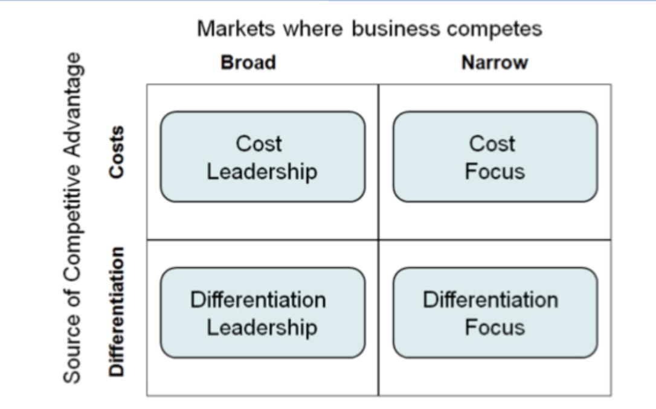
Porters Generic Strategies (1980)
International
Local Market
Specific country
Specific geographical area
E.g. Primark
E.g. A Indian Restaurant in Wrexham
Design
E.g. Apple

Slide 23
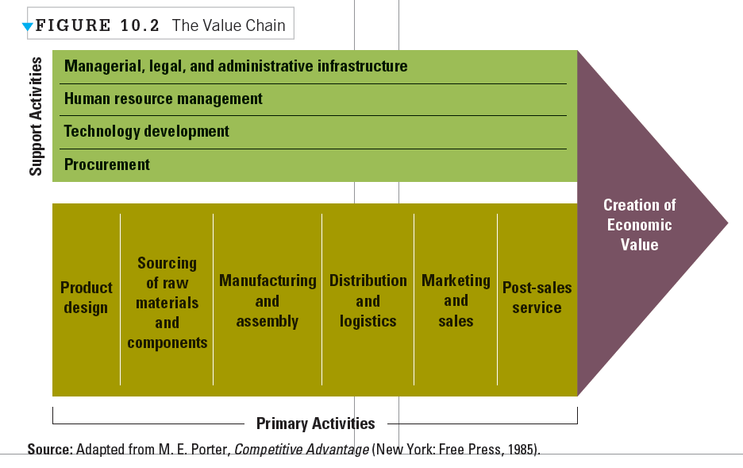

Slide 24
PEST analysis
A scan of the external macro-environment in which the company wants to operate (or operates) and can be expressed in terms of the following factors:
Political
Economic
Social
Technological
https://www.youtube.com/watch?v=UYQItP5_1AQ

Slide 25
PEST Analysis - market, business, proposition, etc.
POLITICAL ecological/environmental issues current legislation home market future legislation European/international legislation regulatory bodies and processes government policies government term and change trading policies funding, grants and initiatives home market lobbying/pressure groups international pressure groups wars and conflict | ECONOMIC home economy situation home economy trends overseas economies and trends general taxation issues taxation specific to product/services seasonality/weather issues market and trade cycles specific industry factors market routes and distribution trends customer/end-user drivers interest and exchange rates international trade/monetary issues
SOCIAL lifestyle trends demographics consumer attitudes and opinions media views law changes affecting social factors brand, company, technology image consumer buying patterns fashion and role models major events and influences buying access and trends ethnic/religious factors advertising and publicity ethical issues | TECHNOLOGICAL competing technology development research funding associated/dependent technologies replacement technology/solutions maturity of technology manufacturing maturity and capacity information and communications consumer buying mechanisms/technology technology legislation innovation potential technology access, licencing, patents intellectual property issues global communications

Slide 26
Improper Business Environment scanning
https://www.youtube.com/watch?v=TIVy1iFePro&t=387s

Slide 27
Situation Analysis - SWOT
Internal Analysis—company; capability etc.
External Analysis—customers, market definition, industry structure
SWOT Analysis
Strengths, Weaknesses, Opportunities & Threats
Identify & prioritize major problems and opportunities: selection of key issues
Based on the firm’s core competencies, decide on future options

Slide 28
SWOT analysis
Internal Environment
Strengths | Weaknesses
World class product Financial resources Know-how | Technical support Internal processes Channels network
External Environment
Opportunities | Threats
Water & Energy crises Environment awareness Productivity improvement | Competitors market share Euro X Dollar Technology development

Slide 29
SWOT
https://www.youtube.com/watch?v=9-NWhwskTO4

Slide 30
Opportunities/Threats
How are demand and supply expected to evolve?
How do you expect the industry chain economics to evolve?
What are the potential major industry discontinuities?
What competitor actions do you expect?
NEUTRALIZE THREATS
BUILD ON STRENGTHS
YOUR BUSINESS
CONVERT OPPORTUNITIES
Strengths/
Weaknesses
What are your BU’s assets/competencies that solidify your competitive position?
What are your BU’s assets/competencies that weaken your competitive position?
Surfaces potential opportunities/threats arising from factors external to the business
ADDRESS
WEAK-NESSES
Can be used as a thought starter for competitive analysis and internal assessment

Slide 31
TOWS matrix
 | Strengths | Weaknesses
Opportunities | S-O strategies | W-O strategies
Threats | S-T strategies | W-T strategies
S-O strategies pursue opportunities that are a good fit to the companies strengths.
W-O strategies overcome weaknesses to pursue opportunities.
S-T strategies identify ways that the firm can use its strengths to reduce its vulnerability to external threats.
W-T strategies establish a defensive plan to prevent the firm's weaknesses from making it highly susceptible to external threats.

Slide 32
Kinds of Strategic Plans
Time Horizon
Level in Organization
Horizons:
Short – 1-3 years
Medium
Long – 5+ years
Length of time horizon:
is industry-specific
may vary by age or firm and its market stability
All plans are subject to annual review
Each organizational level has its own plan
Each level’s plan is more specific than that of the level above
Functional areas within each level have their own specific plan

Slide 33
Any Questions

